Slide 1



HazardWatch
Created By Dion Hutch

Slide 2
The Problem
Staff can’t watch every area in large buildings
Hazards like spills, blocked exits, and obstacles are often missed
Missed hazards lead to accidents, delays, and safety risks
Public spaces need faster, real-time detection

Slide 3
The Solution
Uses AI to monitor camera feeds
Detects hazards instantly (spills, obstacles, blocked exits)
Sends alerts to staff so issues are fixed quickly
Improves safety and accessibility for everyone

Slide 4
How the AI Works
Simple computer vision object detection model
Trained on public indoor safety datasets
Only detects hazards, does not identify people
Works in real time on normal camera feeds

Slide 5
Market Fit
HazardWatch is useful for:
Malls
Schools
Movie theaters
Warehouses
Public walkways & transit areas
Value:
Faster hazard response
Fewer accidents
Better accessibility compliance

Slide 6
Ethics
No facial recognition or tracking
Uses only non-personal image data
Alerts must be confirmed by a human
Designed only for safety — not surveillance
Clear ethical use guidelines included

Slide 7
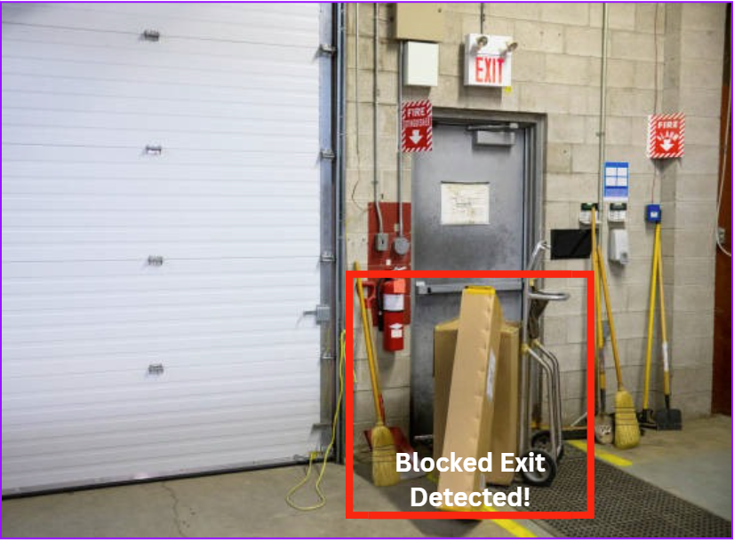
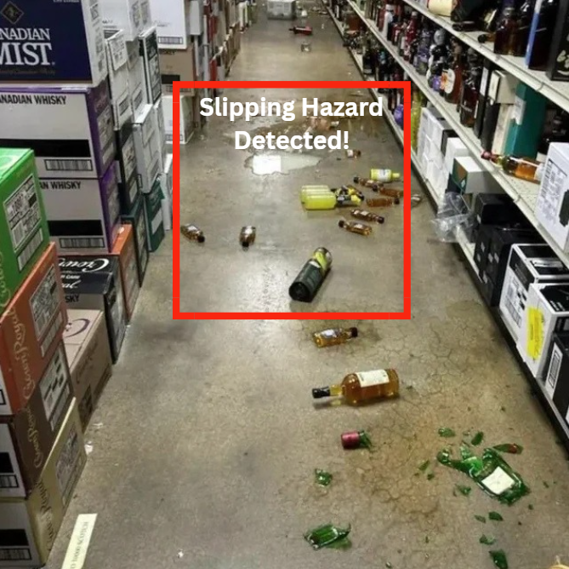
Demo Images
Blocked Exit Detection:
AI identifies objects blocking emergency exits
Draws a red hazard box around the obstruction
Alerts staff to clear the path for safety
Spill/Trip Hazard Detection:
AI detects floor spills or any tripping hazard in real time
Highlights the hazard with a red hazard box
Helps prevent slip-and-fall accidents

